Slide 1
Sprint #4 Presentation
Jamil Khan, Chaz Del Prato, Benjamin Seo, Christine Duong, Brandon Le, John Him

Slide 2
Updates
Management Plan
Gantt Chart
Burndown Chart
Project Tracking Matrix
Team Code Velocity
Sprint Retrospective

Slide 3
Sprint Goals
Database/Back-End Profile Editing
Test Account Creation and Login
Database/Back-End Account Creation
UI for Login to Website using Google Account
UI for Player Profile
Test Profile Editing
Create Test Plan
Update Architecture and Design Document with Required Sections for Machine Learning
Machine Learning Planning

Slide 4
User Stories for This Sprint
Management Team:
As a member of the management team, I want a detailed plan of how machine learning is going to implemented, so that we can execute our model effectively and correctly.
As a member of the management team, I want to have a test plan, so that we can test the functionality of our product
As a member of the management team, I want all of our documents to be revised and up to date, so that we ace proceed with our next sprints

Slide 5
User Stories for This Sprint
Player:
As a player, I want to be able to edit a profile that shows my age, skill level, and interested sports, so that I get notified when a related game is started.
As a player, I want to be able to create an account and log in, so that I can use to product to the fullest potential.

Slide 6
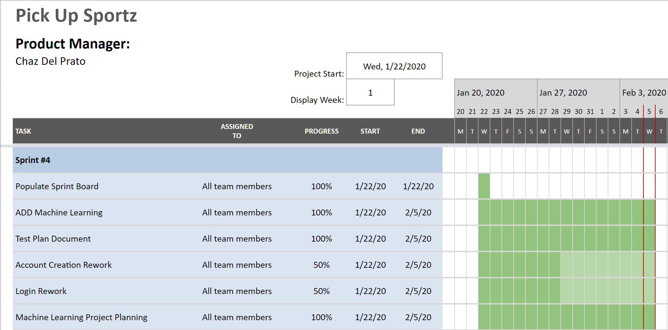
Gantt Chart

Slide 7
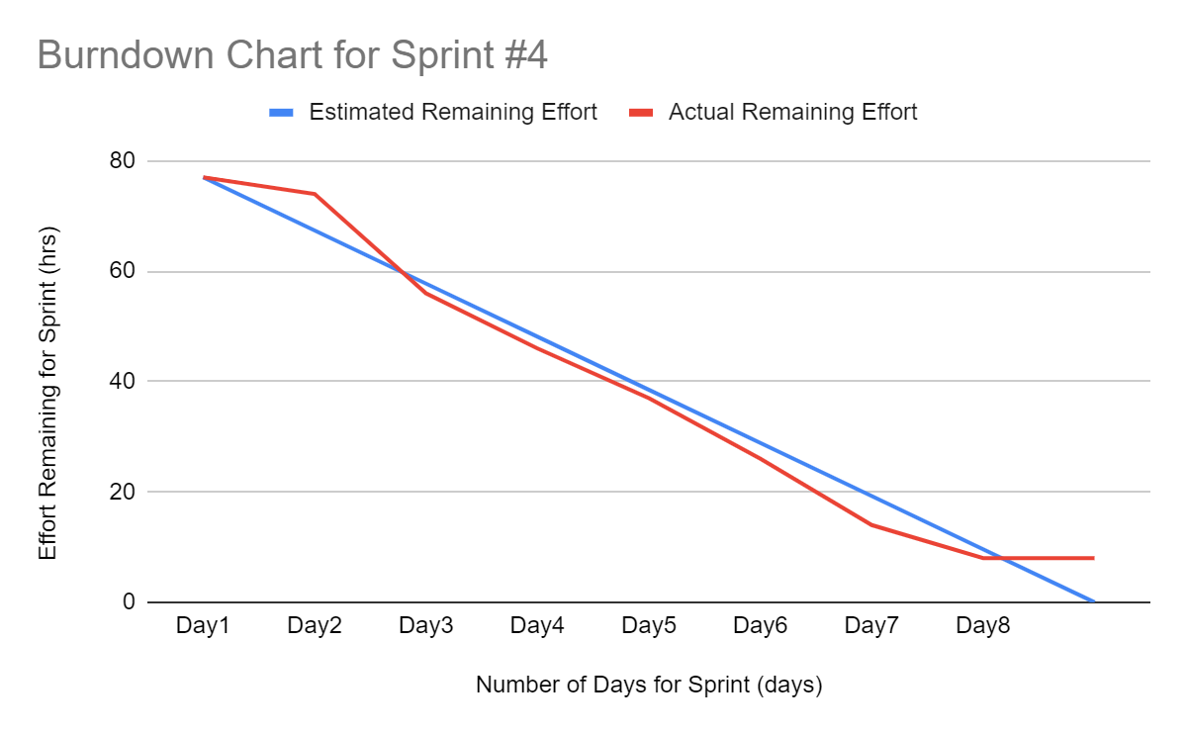
Burndown Curve

Slide 8
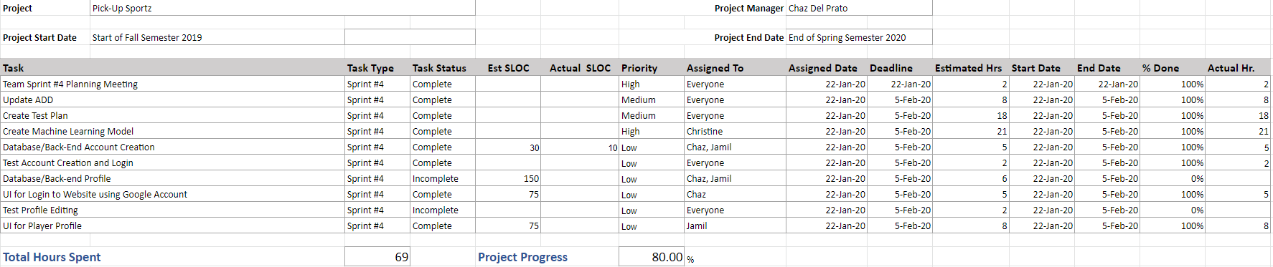
Project Planning Matrix

Slide 9
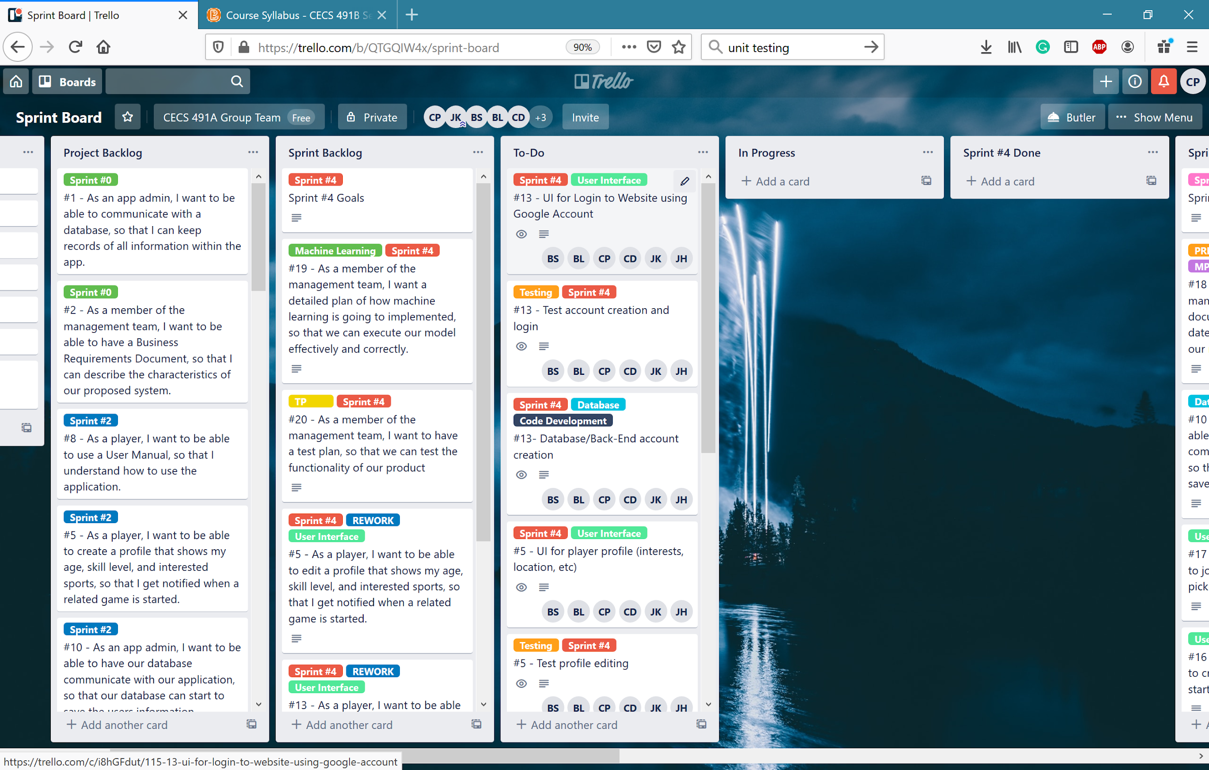
Sprint Board (Start)

Slide 10
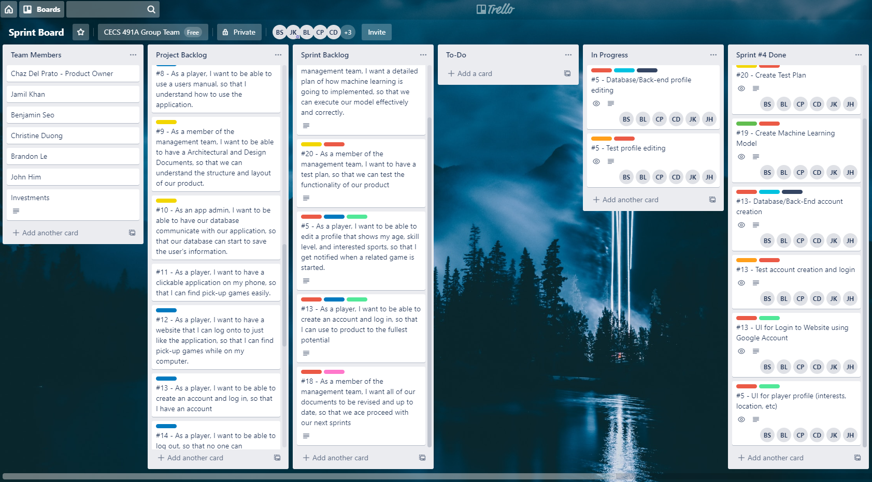
Sprint Board (End)

Slide 11
Test Plan
1. Test philosophy
a) Could you test everything you can think of? What criteria are you using to select what gets tested?
Yes we could test everything we can think of. The criteria we are using to select what gets tested is based on the user’s perspectives of their activities
b) Are there different densities of testing across your code? Will less well understood code go through more testing? Is there a code that does not require testing?
There are different densities of testing across our code. For example, we would test heavily on the primary functions like joining/creating an event and the machine learning component. We would focus less on more simple portions of the applications such as logging in/out, create account, modify settings, etc. For less understood codes, they will be tested more than simple codes but not as much compared to codes for like machine learning.

Slide 12
Test Plan
c) Why would your selected testing program be sufficient? What criteria do you use for making that decision?
We believe that the selected testing program would be sufficient due to the coverage of priority. The testing will cover all of our components in our application but with different priorities. For example, main functions and components will be tested more than smaller functions like UI. These are part of the criteria that we use to make our decision. The criteria would be to test everything but through a priority-based system.

Slide 13
Test Plan
2. Team Workflow
a) What is your team’s test process?
Finish a function, then test it. Do this repeatedly until all of the functions are done. We will then connect those functions to each other and test the whole application.
b) How do you determine code coverage?
We first decide who wants to do what. Then, we will cover the untaken tasks with other teammates. Since our team does not really care so much on what portion of tasks they are assigned, dividing the task is fairly simple.

Slide 14
Test Plan
c) Do bugs come back from users or from your own team affect your test program workflow?
Bugs would come back from users and from our own team. While users would report them to us, our team will constantly monitor any bugs throughout developing our web application. These bugs will not affect our test program workflow since most bugs will be anticipated. For those that might affect our testing workflow, we believe that it can be mitigated due to our team’s knowledge of their work

Slide 15
Test Plan
3. Test Design
a) Code paths
Unsure on how to answer this, but from what is suggested from an online source is to use Basic Path Testing. It is based on a White box testing method that defines test cases on the flows or logical paths that can be taken through the program. It involves execution of all possible blocks in a program and achieves maximum path coverage with the least number of test cases. It is a hybrid of branch testing and path testing methods. To do this, we must first draw a control graph, calculate the cyclomatic complexity, find a basis set of paths, then generate test cases to exercise each path. The advantages for using basic path testing path testing are that it helps to reduce redundant tests, focuses attention on program logic, helps facilitates analytical versus arbitrary case design, and for each test cases, execute every statement in a program at least once.

Slide 16
Test Plan
b) Code coverage estimation in terms of % lines of code tested (related to (a) above)
Unsure on how to answer this but from what we have found online, we will be using a formula: Tcov = (Ltc / Lcode) * 100%, where Tcov = test coverage, Ltc = number of lines of code covered by tests, and Lcode = the total number of code lines. From our online research, they suggest using a toolkit called Clover that allows you to analyze which lines were entered during testing so that we can significantly increase the coverage by adding new tests for specific cases. In addition, it can get rid of duplicate tests.
c) Environment
Unsure on how to answer this, but for what we have found online suggest that we should determine if test environment needs archiving in order to take back ups, verify the network configuration, identify the required server operating system, database, and other components, and Identify the number of license required by the test team.

Slide 17
Test Plan
d) Test code and data
Unsure on how to answer this, but online sources suggest using given softwares to test our code and data. For example, python has several testing softwares to use. These include, unittest, doctest, py.test, hypothesis, etc. We need to learn more about this to answer this question completely and correctly.
e) Version control methodology (of your product code, test code and test drivers. Do you track bugs?)
For what we can understand, we will be using GitHub to simultaneously work on the same version without hindering each other’s work. For every build we release, we will try to find bugs from our own testing or from other user’s. We will then try to fix those bugs and release an updated version of the web application.

Slide 18
Test Plan
4. For Every Test Case:
a) Requirements or behaviors, i.e. what your tests are trying to verify (requirements) or validate (user needs) for every test – Is there a more systematic way to establish this?
For every test case, our requirements will be whether it works or not. It is still too early for us to know what all our requirements and behaviors are. However, for what we know right now is that our test cases will primarily focus on whether or not our goals will be reached. For example, test functionalities for all of the required portions of the web application. If they the testing goes well for those, move on to the other required functionalities.

Slide 19
Test Plan
b) Evaluation criteria (e.g. pass/fail) and disposition
Similarly to the questions above, we are unsure on how to answer this with what we know right now. However, in the simplest way to answer this, we will evaluate our program through if it works or not. These would primarily be focused on the functionalities that are must have in our applications. If it is what we desired and it works, then it passes. If it is what we desired, but does not work, it fails and needs to be worked on.

Slide 20
Project ML Planning
Business problem definition
We want to solve the issue of deciding what new sports the users would be interested in trying out.
Features (inputs) and prediction for your model
Based on what sport(s) the user has played as well as the data we have gathered through surveys, our decision tree model will be used to suggest a new sport that may have similar skills or rules to the sport(s) they’ve played in the past.

Slide 21
Project ML Planning
Input data source(s) and project plan for training data
80% of the data we collect with be used to train the model
20% of the data will be used to test the model
Model(s) English descriptions
Decision Tree ML Model: A question is asked, called the root and the answers will result in either ‘yes’ or ‘no’, creating two leaves. The line connecting the root to the leaf is called a branch. This algorithm will predict the probability a user will be interested in trying out a particular sport.

Slide 22
Project ML Planning
Tentative deployment plan (deployment architecture description)
First gather data. Then, implement data into the decision tree. Test 20% and train 80% of the data sets. Once we have a solid foundation, we will deploy it to our web app while connecting other components, like our database, to it.

Slide 23
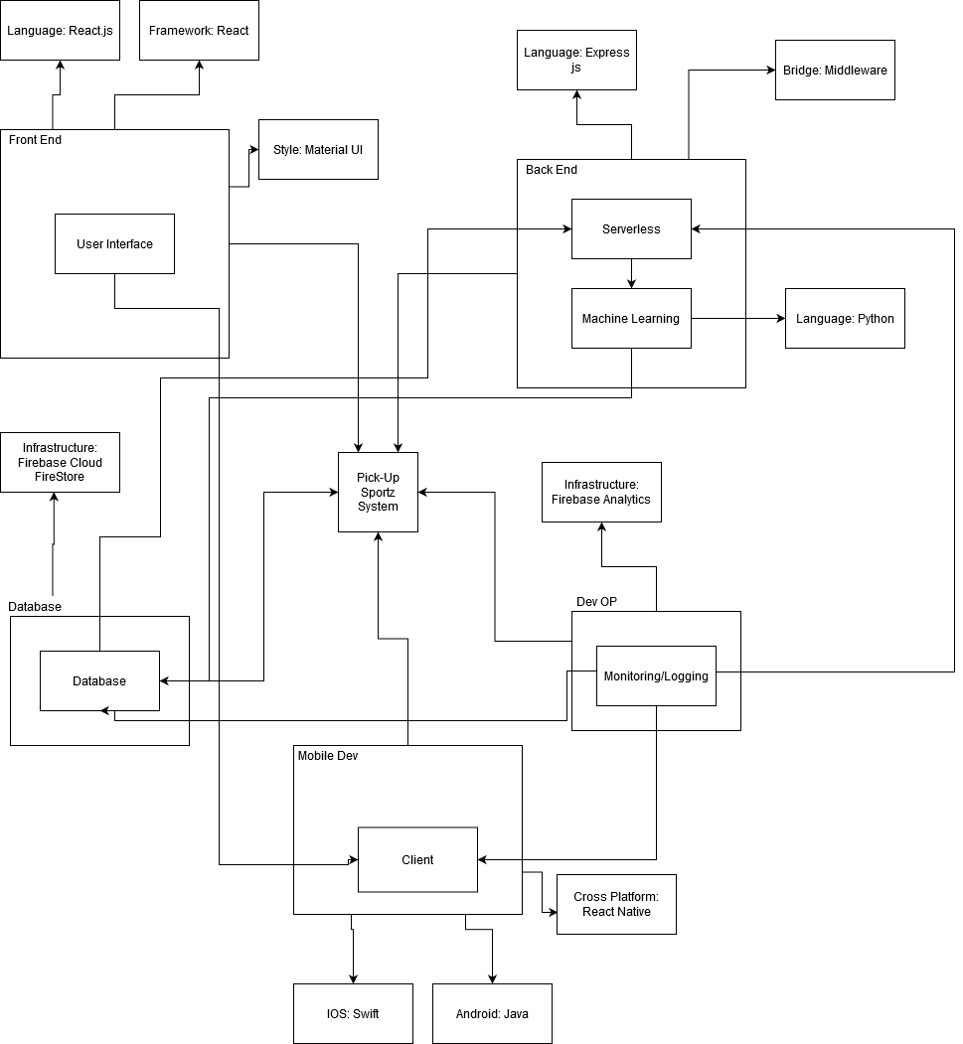
Briefly describe the architecture including the major components and interactions among the major components.

Slide 24
Machine Learning Model
How many features are there in a data sample?
Type_Sport, Gender, Skill_Level, Last_Month_games, Last_3m_avg_games, Players_Rating
What is the source of the training data?
We will be creating our own dataset so we will take an approach of gathering information on what sport it was, their gender, their skill level, their player rating, and the games they have played.
Did the team plot the data correlation between features and the label? What business relationship between features and labels that you can tell?
Since we do not have our datasets yet, we cannot plot them. However the correlations between the features and the label

Slide 25
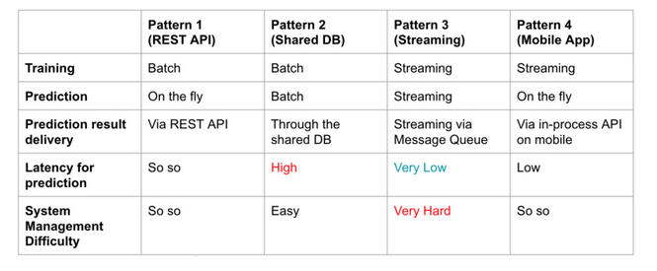
Machine Learning Deployment
How do we plan to deploy the machine learning model?
At the moment, we are planning on deploying our model as a Web API.
Alternative deployment architectures?
REST API = Web API
Notes:
Chaz

Slide 26
ADD Machine Learning Required Sections
How many APIs and servers are there?
We plan on using the Machine Learning Kit on Firebase.
We using Firebase Hosting, so we are serverless at this point.

Slide 27
User Features
How many total user features?
Create account, profile, event and log in/out
There has been no new user features added this sprint. We have been working on fixing the existing issues from last semester.

Slide 28
What type of Object Relational Model (ORM), Object Data Modeling (ODM) library or driver is used in the connection of database to the server?
JSData
JSData converts data from JavaScript Objects to formats used by MySQL, MongoDB, RethinkDB, Firebase, etc. and vice versa

Slide 29
Sprint Retrospective
Our goal was to:
Database/Back-End Profile Editing
Test Account Creation and Login
Database/Back-End Account Creation
UI for Login to Website using Google Account
UI for Player Profile
Test Profile Editing
Create Test Plan
Update Architecture and Design Document with Required Sections for Machine Learning
Machine Learning Planning

Slide 30
Sprint Retrospective
Our team’s total velocity is :
5 hours x 2.5 weeks x 6 members = ~75 hours (story points).
We were not able to meet our sprint goal.
Underestimated on how much we could do when planning.
What we did not finished:
Finish the Database/Back-end for profile editing
Test profile editing

Slide 31
Sprint Retrospective
Current hours worked:
69 hours (story points).
Burndown Chart Analysis:
Our burndown chart for sprint #4 is not bad, but shows that we have not finished on what we planned on. We mostly had problems with answering some of the questions for the required sections in the Architecture and Design Document. Thus, we had to revise our model.
As a team, we decided to assign priority to each story based on how much work needed to be done. We mainly focused on starting the Test Plan, Determining our Machine Learning Plan, and updating our Architecture and Design Document.
There is no In Progress user stories. Since we are only fixing problems from last semester, the code has already been evaluated.

Slide 32
Sprint Retrospective
Team velocity for next sprint:
Extend our team velocity back to 90 hours.
Plan efficiently
Try to work 5 hours x 3 weeks x 6 members

Slide 33
Code Review
Updated account creation to actually save to the database.
https://pick-up-sportz-89c6e.firebaseapp.com/

